Slide 1

San Luis Obispo County, CA
Travel Management Coordination Center (TMCC)
Federal Transit Administration
Mobility Services for All Americans (MSAA) Initiative
USDOT Workshop: “Mobility and Technology Solutions for Coordinated
Human Services Transportation Systems”
Presentation by: Todd Allen, RouteMatch Software
Asheville, North Carolina
October 3, 2016

Slide 2

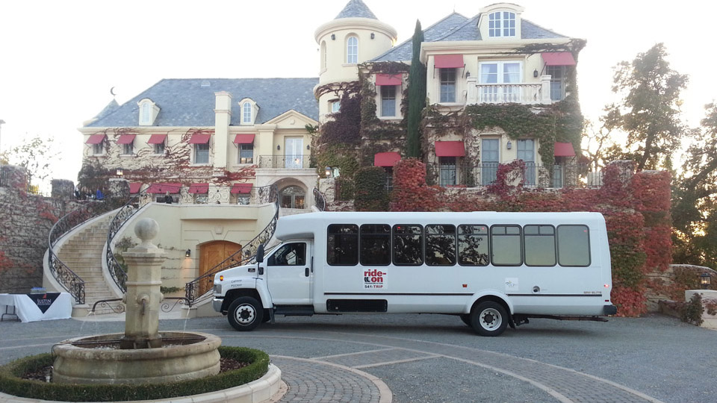
San Luis Obispo County TMCC/MSAA Project
Today’s Discussion Topics
Project Overview
Current Status
Next Steps
Conclusion
Notes:
MSAA Project Overview

Slide 3

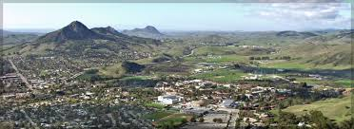
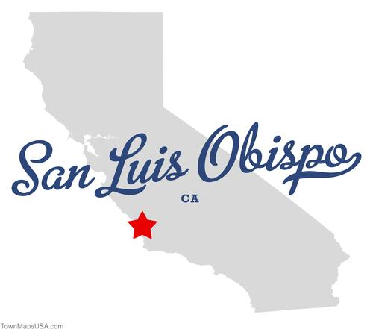
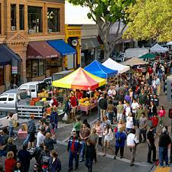

San Luis Obispo County TMCC/MSAA Project
Notes:
Project Location: San Luis Obispo, CA;
SLO city is home to ~45,000 persons;
SLO County is home to 269,637 (2010 Census) persons;
Covers 3,299 square miles
The county has multiple municipalities

Slide 4
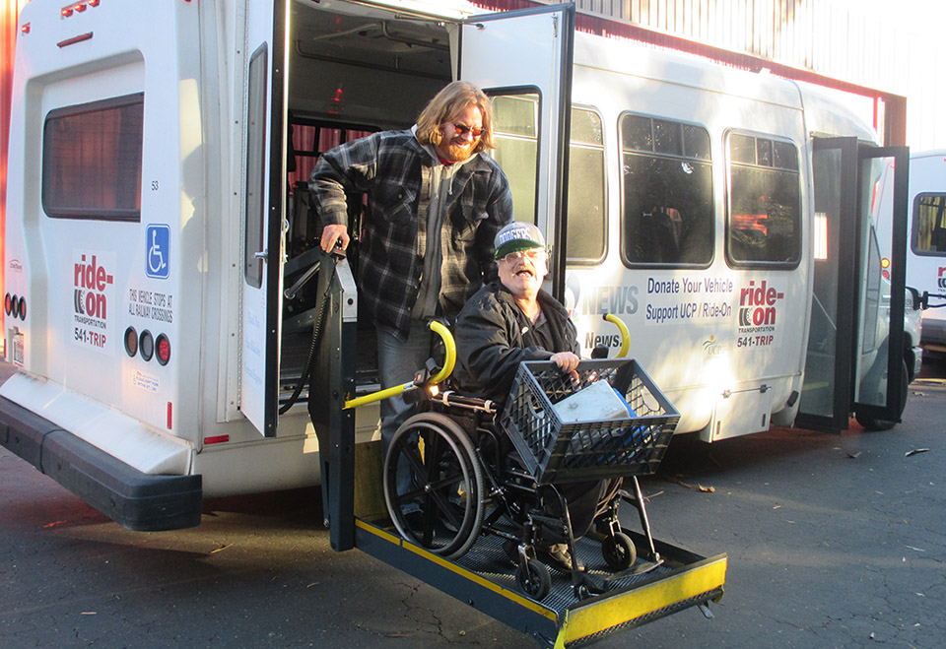
San Luis Obispo County TMCC/MSAA Project
Project Overview - TMCC Vision:
“To enhance personal mobility across San Luis Obispo County”
Notes:
Current project Deliverable.

Slide 5
San Luis Obispo County TMCC/MSAA Project
Project Overview
FTA MSAA Grant Award: 2015
Purpose: Provide customers with real-time paratransit information and services through the coordination of public, private, and human service transportation.
Leverage: Intelligent Transportation Systems (ITS) – Systems Engineering process to design a scalable and replicable TMCC.
Expected Outcomes:
  (1) Explore potential local institutional barriers.
  (2) Identify opportunities to coordinate public, private, and non-profit agency paratransit trips through ITS.
  (3) Provide customers with real-time information and services.
  (4) Create a detailed set of system engineering documents to build, fund, and sustain the TMCC.
Notes:
MSAA Project Overview

Slide 6








San Luis Obispo County TMCC/MSAA Project
Project Overview – Stakeholders
United Cerebral Palsy of San Luis Obispo County/ Ride-On Transportation
San Luis Obispo Regional Transit Authority (RTA)
San Luis Obispo Council of Governments
RouteMatch Software
Community Health Centers
San Luis Obispo Regional Rideshare
San Luis Obispo Safe Ride
Yellow Cab
Smart Shuttle

Slide 7
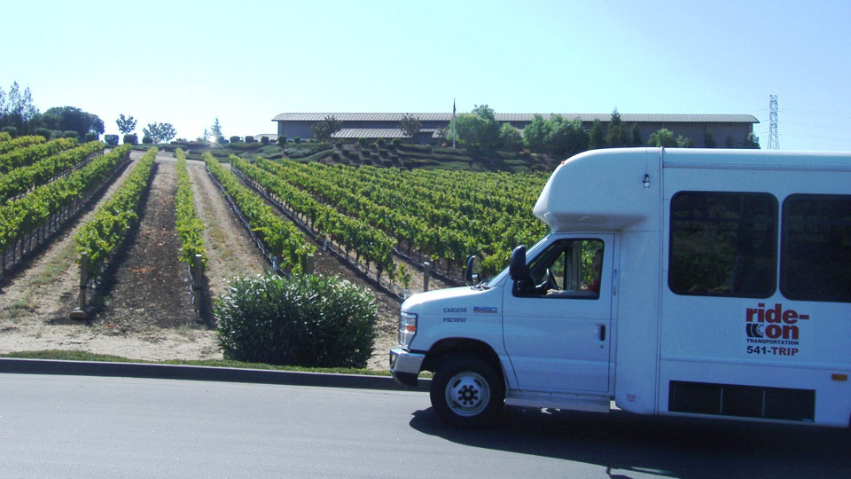
San Luis Obispo County TMCC/MSAA Project
Project Overview – Stakeholders, continued
United States Department of Transportation (USDOT), Federal Transit Administration (FTA)
California Department of Transportation (CalTrans)
City of San Luis Obispo (SLO Transit)
CenCal Health (Medi-Cal)
City of Morro Bay
USDOT/Federal Highway Administration (FHWA)
Other Human Service and Community Organizations
Technology Partners
All others are welcome!

Slide 8
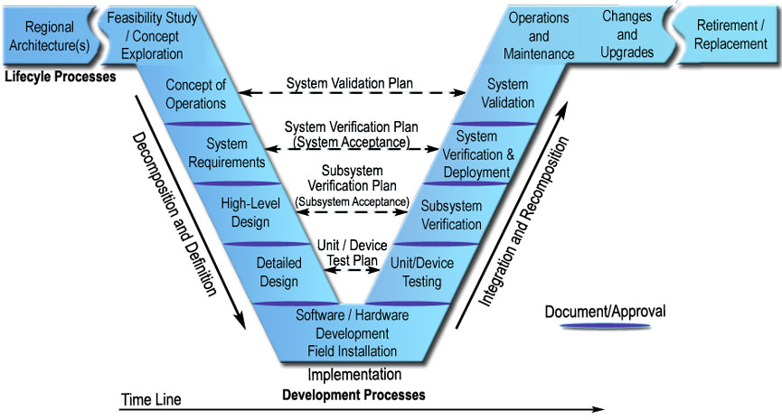
San Luis Obispo County TMCC/MSAA Project
Project Overview - Process
Initial site visit by FTA.
Stakeholder Advisory and working subcommittees established.
Project Plan creation.
ITS Systems Engineering process – development of written deliverables:
  Concept of Operations
  System Requirements
  High-Level Design
Systems Engineering “V” Diagram - Illustration Courtesy of FHWA http://ops.fhwa.dot.gov/publications/seitsguide/section3.htm

Slide 9
San Luis Obispo County TMCC/MSAA Project
Project Overview - Process
Concept of Operations (ConOps) Creation
  Identifies “what is” the TMCC from a stakeholder and customer perspective.*
  Communicates the TMCC’s characteristics to all stakeholders.*
  Ensures all stakeholders and customers have an understanding of the TMCC.*
  Provides operational needs and proposed characteristics for proposed TMCC.*
  Describes high-level user expectations and functional requirements for TMCC.*
  Describes information sharing across programs and operators.*
  Flexibility. Can be modified at anytime during the project.*
  Enables community needs solicitation.
    General public, community organizations, human service agencies, transportation providers, others.
    Project website, online and printed surveys – English/Spanish languages, in-person discussion.
* Source: FTA MSAA Deployment Planning: Webinar #3, An Overview of Concept of Operations, March 2, 2016
Notes:
As a refresher - why develop a Concept of Operations (ConOps)?

Slide 10
San Luis Obispo County TMCC/MSAA Project
Current Status
Ongoing Stakeholder Engagement – Absolutely Critical
  Stakeholder Meetings
    TMCC Advisory Committee – held quarterly.
    Subcommittee (3) meetings – Held monthly (Transportation Providers, Technology, Riders/Users).
    Facilitates open/transparent project dialogue among partners.
    Encourages “buy-in” or understanding and agreement among stakeholders.
    Transportation Provider board inclusion at key decision points.
  Regular Communication
    Regular project communication with stakeholders – find the right balance of information sharing and preferred medium.
Notes:
Elements of the proposed hypothetical TMCC system – per customer/stakeholder needs.

Slide 11
San Luis Obispo County TMCC/MSAA Project
Current Status
Addressing Institutional Challenges (examples)
  Transportation Providers
    Inter-agency agreements and business processes, services/requirements, cost/accounting, organized labor contractual requirements, trips sharing/ownership (customer care), driver training, insurance, maintenance, communication, service provision consistency, etc.
  Funding Sustainability
  Technology systems
    Transportation Provider - ITS, telephony.
    TMCC access for all persons.
    Existing vs. future communication platforms (i.e. 511, 211, and others).
Ongoing Transportation Coordination Discussion
  Timing. MSAA process and recently completed regional coordination plan have expanded ongoing, regular topic-related discussion.
    MSAA has facilitated new stakeholders in the coordination conversation.

Slide 12
San Luis Obispo County TMCC/MSAA Project
Current Status
Proposed Hypothetical TMCC System: Elements
  TMCC Focus: Customer access to transportation information and demand response transportation (DRT) provider services.
  Customer Access Methods: In-Person; Telephone; Website, and Mobile App.
  Staff Web Portal: Quick staff access to specific website elements (i.e. trip reservations) for enhanced customer service.
  TMCC Database and Data Dictionary: Centralized data and definitions (what to do with the data?).
  Application Program Interfaces (API): Electronic “connectors” between the database/data dictionary and the DRT service providers.
  DRT Service Providers: Leverage existing technologies to support TMCC services.
Notes:
Elements of the proposed hypothetical TMCC system – per customer/stakeholder needs.

Slide 13
SLO County TMCC Project - Proposed Hypothetical System High-Level Architecture
Notes:
Proposed hypothetical TMCC system – high-level architecture.

Slide 14
San Luis Obispo County TMCC/MSAA Project
Current Status
Proposed Hypothetical TMCC System: Customer Services
  Real-Time DRT Services (examples)
    Trip scheduling across multiple DRT Providers – based on service availability.
    Secure customer login and “new customer” registration capability.
    Proposed DRT trip fare cost information availability.
    Provide real-time DRT Provider vehicle arrival information.
    Common fare system.
    Trip scheduling confirmation and verification.
    Access to scheduled and completed trip history.
  Transportation Information (examples)
    DRT and Fixed Route (FR) transit provider information (routes, schedules, contact information, physical location).
    Links to 511, 211, Regional Ride Share, and other project stakeholders.
    Trip itinerary journey planning.
    Access to live staff with direct call transfer capability to project stakeholders.
Notes:
Elements of the proposed hypothetical TMCC system – per customer/stakeholder needs.

Slide 15
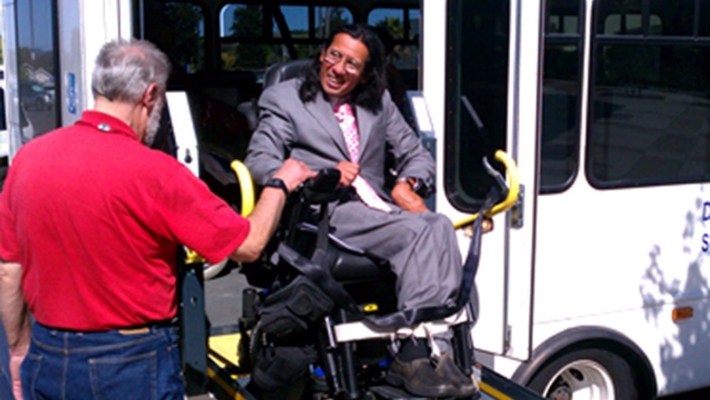
San Luis Obispo County TMCC/MSAA Project
Next Steps…
Upcoming Project Deliverables - Preparation
  System Requirements
  High-Level System Design
  Phased Implementation Plan
  Final Report
Advisory Committee and Subcommittee Meetings
  Stakeholder participation.
Ongoing Research – Best Practices
  Continued research into available technology options to meet TMCC needs.
Notes:
Summarize Presentation:

Slide 16
San Luis Obispo County TMCC/MSAA Project
Conclusion
Awareness - Learn from Others
  The team appreciates learning your experiences. Please share any ideas with us!
Knowledge Transfer - Share the Experience
  New! Creation of a project “cookbook” as a future knowledge transfer/sharing resource.
For more information, visit the SLO County MSAA project website at:
http://ride-on.org/msaa.php
Notes:
Summarize Presentation:

Slide 17
San Luis Obispo County TMCC/MSAA Project
Questions? Comments?
Project Contacts:
  Mark Shaffer, Project Manager, Ride-On Transportation: (805) 541-8751, shafmt@aol.com
  Geoff Straw, San Luis Obispo RTA: (805) 781-4465, gstraw@slorta.org
  Omar McPherson, San Luis Obispo RTA: (805) 781-1171, omcpherson@slorta.org

